Slide 1



Water Potability
Drinking Water Quality

Slide 2

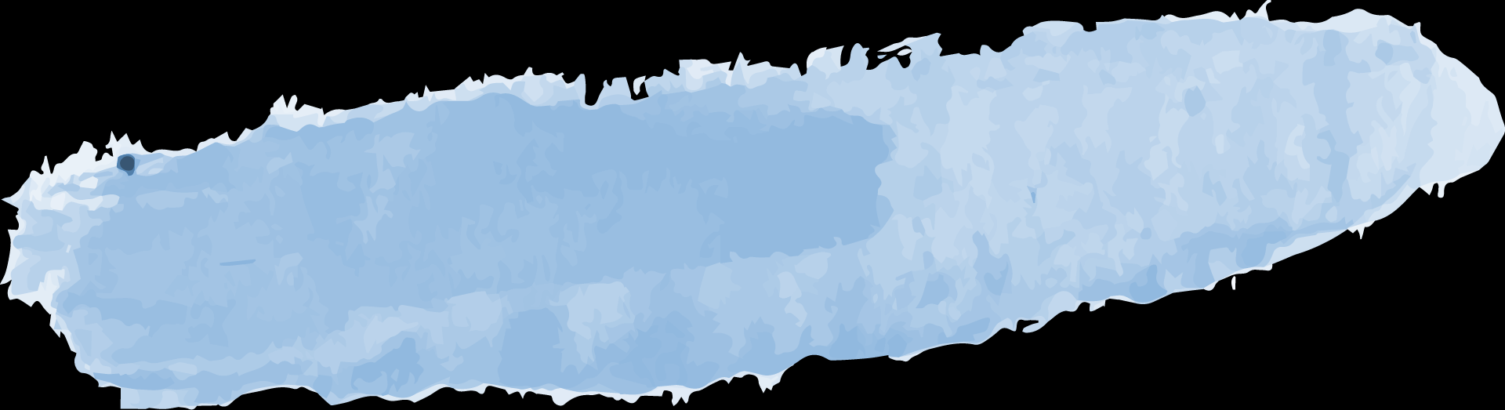

Radia Rayan Chowdhury
Course Name: MSc in Applied Data Science
Teesside University

Slide 3
Introduction

Slide 4
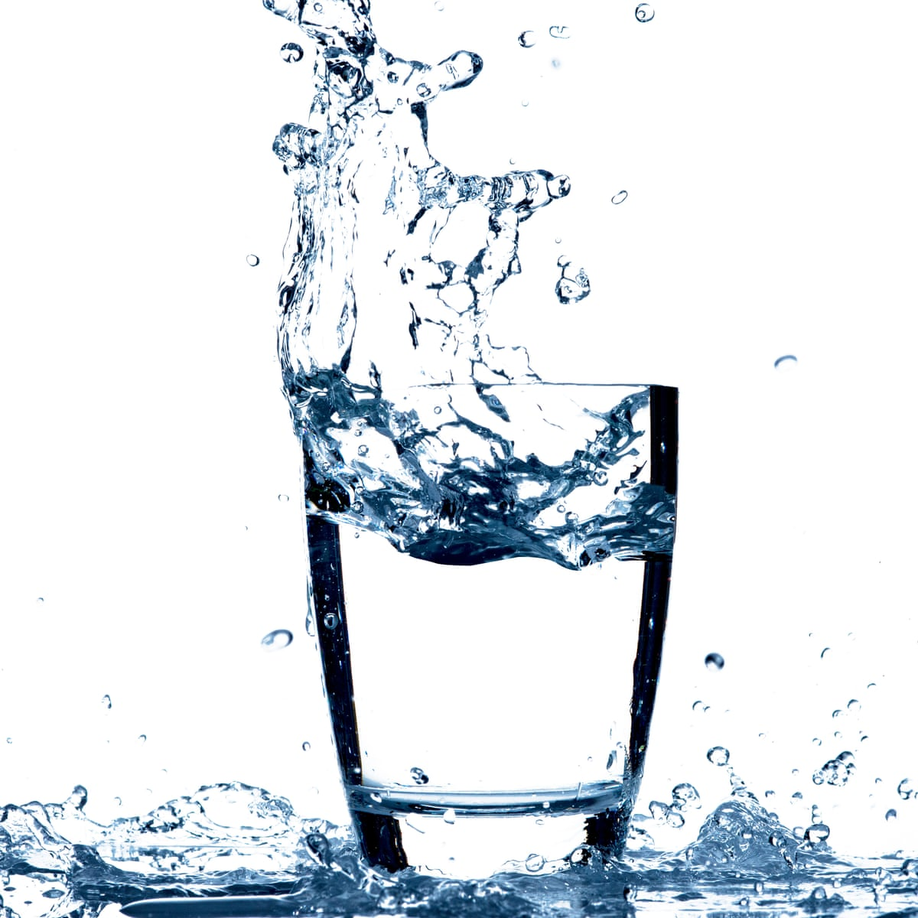
Potable Water
Water that is safe to drink or use for food preparation
Potability: water is safe to drink or not
Refers to the chemical, physical and biological characteristics of water

Slide 5
Features of Water
PH
Hardness
Solids
Chloramines
Sulfate
Conductivity
Organic-
carbon
Trihalo-
methanes
Turbidity
Potability

Slide 6
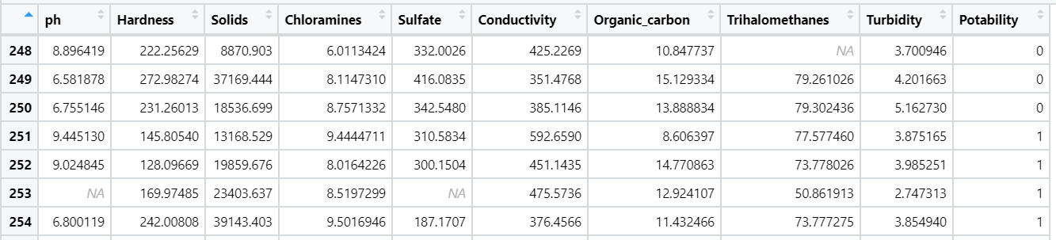
Dataset – Water Potability
Target Variable
Potability 1 means Potable and 0 means Not potable

Slide 7
Reason for choosing this dataset
Safe drinking-water is essential to health
Global Water Crisis
Waterborne Diseases:
Diarrhoea
Cholera
Dysentery
Typhoid
Polio
Goal: To find a relationship between water potability and various features of water

Slide 8
Literature Review
Population and Water Resources: A Delicate Balance
Author: Malin Falkenmark and Carl Widstrand
DRINKING WATER IN DEVELOPING COUNTRIES
Author: Ashok Gadgil
U.S. Drinking Water Challenges in the Twenty-First Century
Author: Ronnie B Levin, Paul R Epstein, Tim E Ford, Winston Harrington, Erik Olson, and Eric G Reichard
Drinking water and cancer
Author: Kenneth P. Cantor

Slide 9
Working Steps
Acquire the dataset
Import libraries & dataset
Analysing the dataset
Data Cleaning
Unimodal Data Visualization
Data Cleaning
Multimodal Data Visualization
Proposed Model

Slide 10
Working Steps
Acquire the dataset
Import libraries & dataset
Analysing the dataset
Data Cleaning
Unimodal Data Visualization
Data Cleaning
Multimodal Data Visualization
Proposed Model

Slide 11
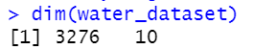
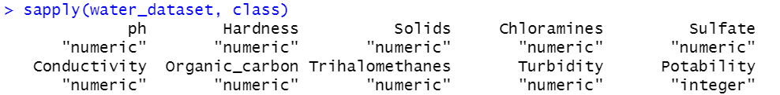
Explanatory Data Analysis
1. Dimension Check
Rows: 3276
Columns: 10
2. DataType Check
We don’t need to change the data type

Slide 12
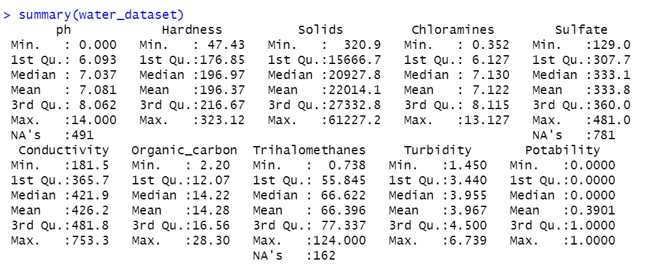
Explanatory Data Analysis
3. Summary Check
There are some NA values in this dataset

Slide 13
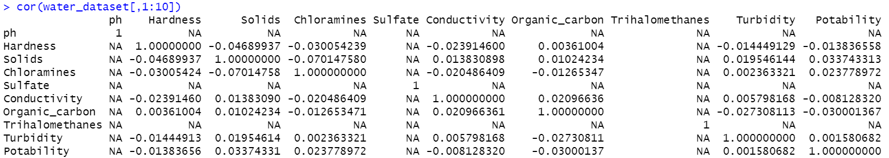
Explanatory Data Analysis
4. Correlation Check
There are some NA values in this dataset

Slide 14
Working Steps
Acquire the dataset
Import libraries & dataset
Analysing the dataset
Data Cleaning
Unimodal Data Visualization
Data Cleaning
Multimodal Data Visualization
Proposed Model

Slide 15
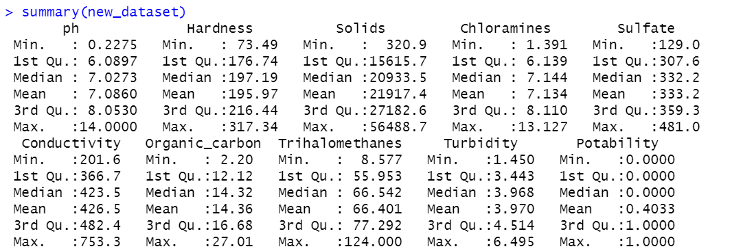
Data Cleaning
1. Handling the missing values by Deleting rows
Summary Check After deleting NA values
No NA values!

Slide 16
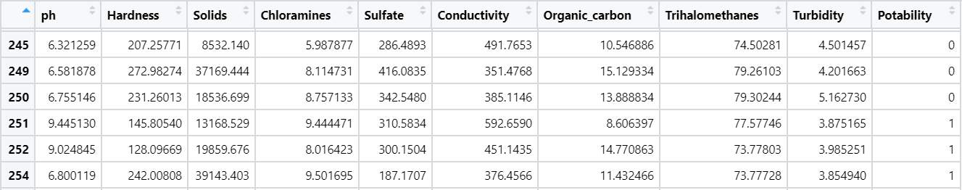
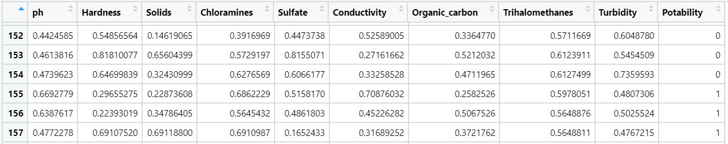
Data Cleaning
2. Feature Scaling using Normalization
Before Normalization
After Normalization

Slide 17
Working Steps
Acquire the dataset
Import libraries & dataset
Analysing the dataset
Data Cleaning
Unimodal Data Visualization
Data Cleaning
Multimodal Data Visualization
Proposed Model

Slide 18
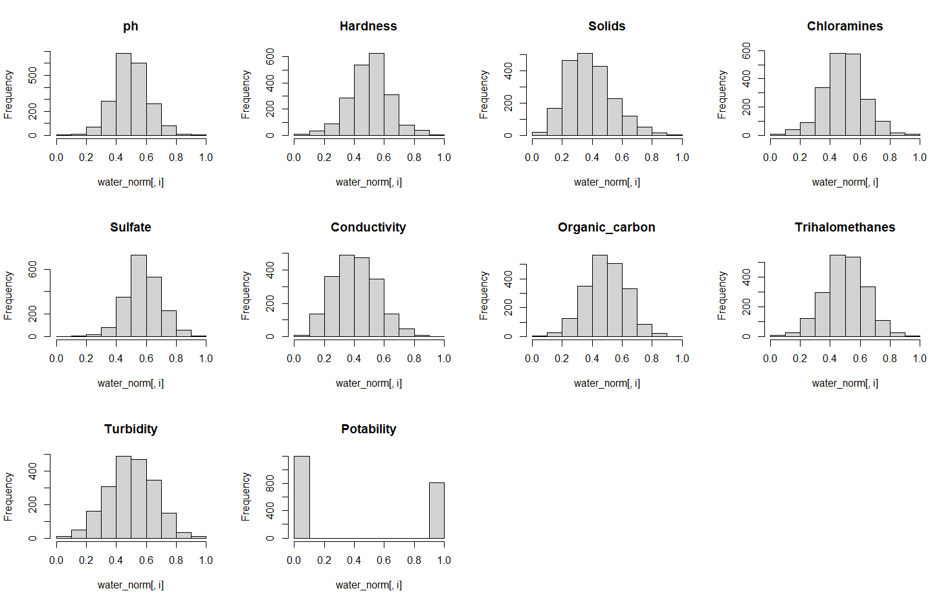
Histogram
Skewed Data!
Fig: Histogram for each Column

Slide 19
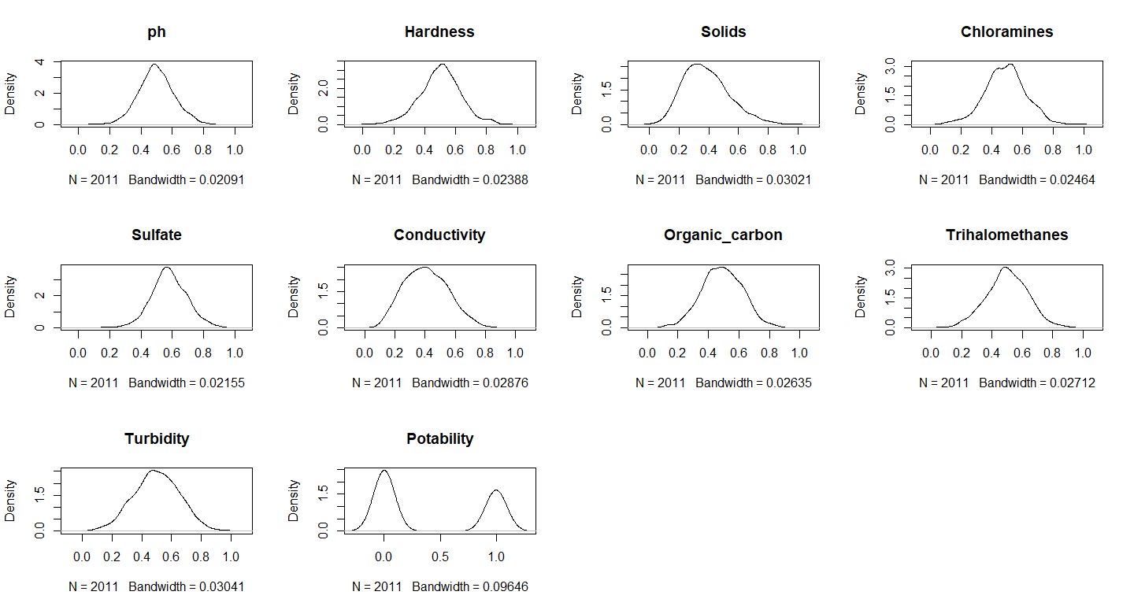
Density Plot
Skewed Data!
Fig: Density Plot for each Column

Slide 20
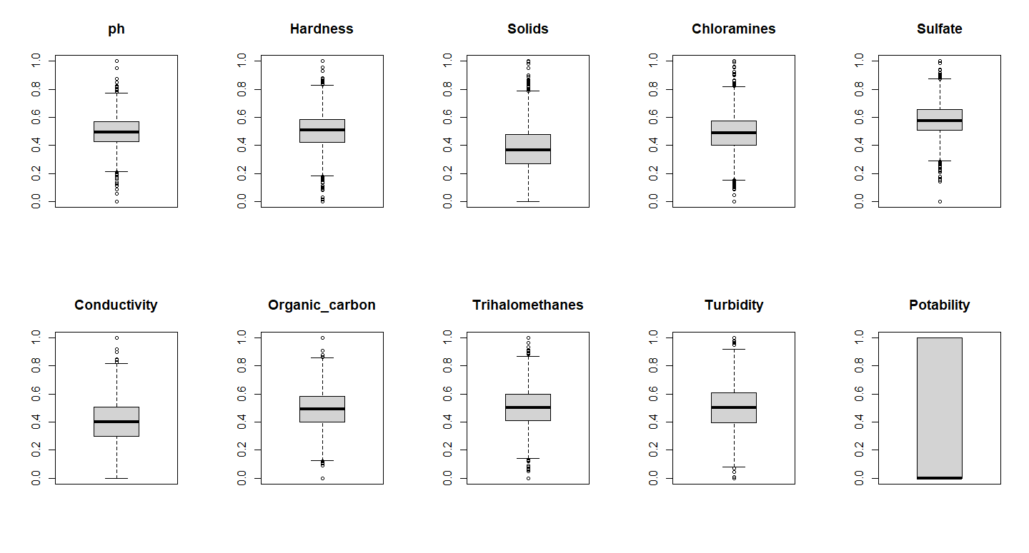
Box Plot
Outliers!
Fig: Box Plot for each Column

Slide 21
Explanatory Data Analysis
5. Skewness of the Data
PH: 0.04887379
Hardness: -0.08511031
Solids: 0.5950054
Chloramines: 0.01295693
Sulfate: -0.04648827
Conductivity: 0.2664708
Organic_carbon: -0.01998781
Trihalomethanes: -0.0513454
Turbidity: -0.03300219

Slide 22
Working Steps
Acquire the dataset
Import libraries & dataset
Analysing the dataset
Data Cleaning
Unimodal Data Visualization
Data Cleaning
Multimodal Data Visualization
Proposed Model

Slide 23
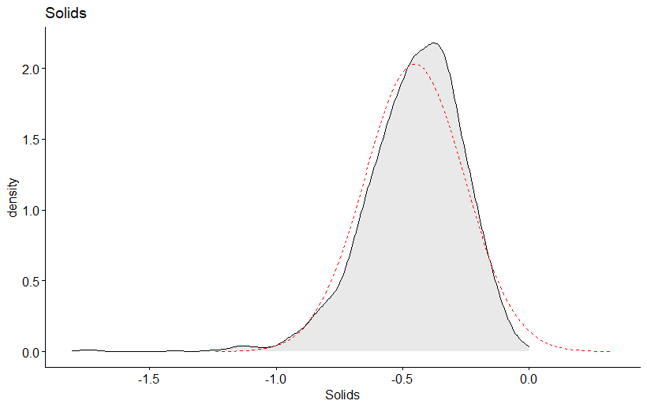
Data Cleaning
3. Log transformation of the skewed data
Fig: Density Plot After Log Transformation

Slide 24
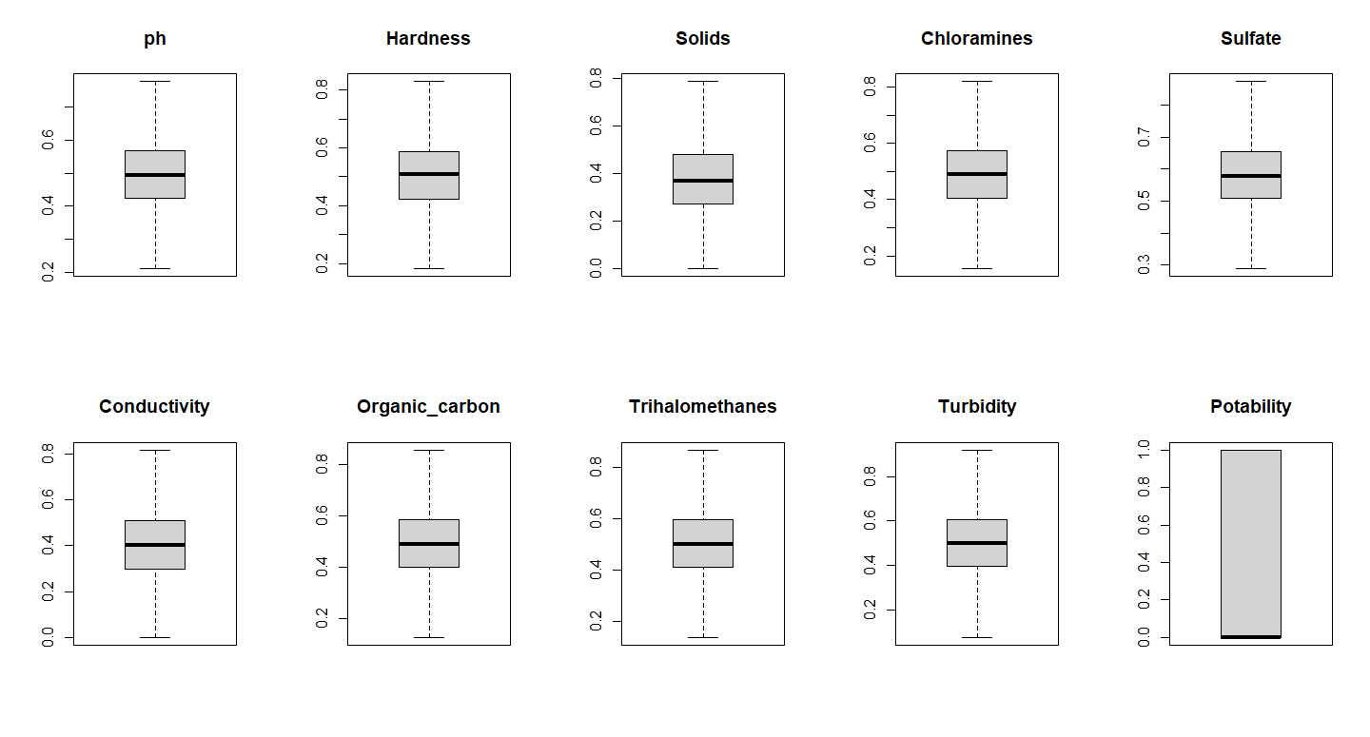
Data Cleaning
4. Remove Outliers
Fig: Box Plot After Removing Outliers

Slide 25
Working Steps
Acquire the dataset
Import libraries & dataset
Analysing the dataset
Data Cleaning
Unimodal Data Visualization
Data Cleaning
Multimodal Data Visualization
Proposed Model

Slide 26
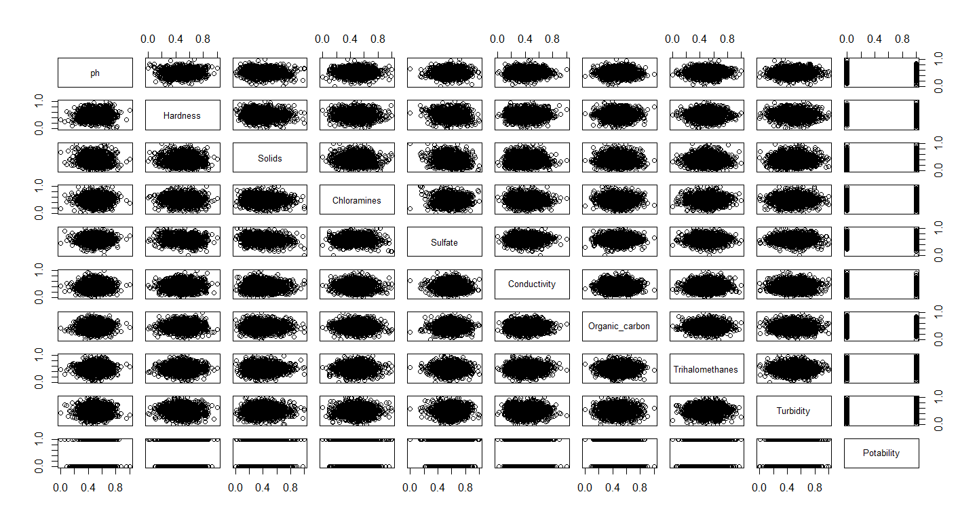
Scatterplot Matrix
Fig: Scatterplot Matrix for each Column

Slide 27
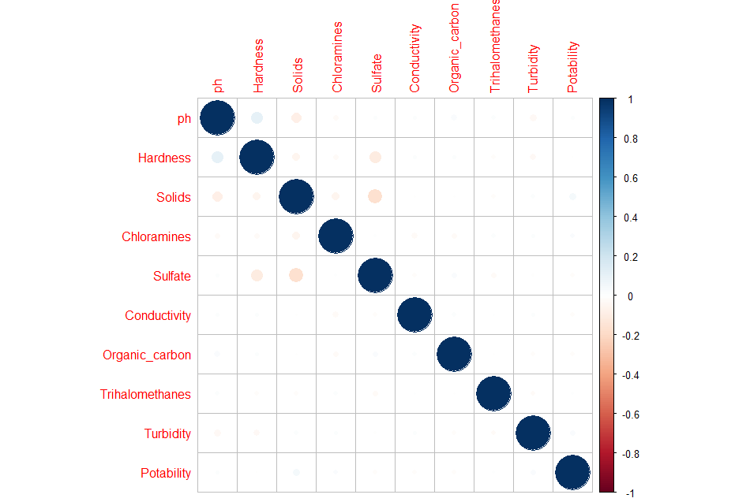
Correlation Plot
Fig: Correlation Plot for each Column

Slide 28
Proposed Model
Supervised Model: the dataset has Label data/dependent variable
We will use binary classification algorithms: logistic regression, and Decision Trees

Slide 29
Plan for the remaining Task
Data preparation: Data Partitioning for Validation
Implemented the proposed model
Evaluate Algorithm: Compare the proposed model with other models
Plot confusion matrix for each model
Calculate Accuracy, Precision, Recall
Plot ROC Curve
Determine which model performs best for this dataset

Slide 30
References
Falkenmark M, Widstrand C. Population and water resources: a delicate balance. Popul Bull. 1992 Nov;47(3):1-36. PMID: 12344702.
Gadgil, Ashok. "Drinking water in developing countries." Annual review of energy and the environment 23.1 (1998): 253-286.
Levin, Ronnie B., et al. "US drinking water challenges in the twenty-first century." Environmental Health Perspectives 110.suppl 1 (2002): 43-52.
Cantor, Kenneth P. "Drinking water and cancer." Cancer Causes & Control 8.3 (1997): 292-308.
Dataset: https://www.kaggle.com/adityakadiwal/water-potability

Slide 31
Thank You

